Slide 1
Applied Statistics
week4
Nov 2017
All client case studies included in
this training are for internal use only

Slide 2
Hypothesis Testing

Slide 3
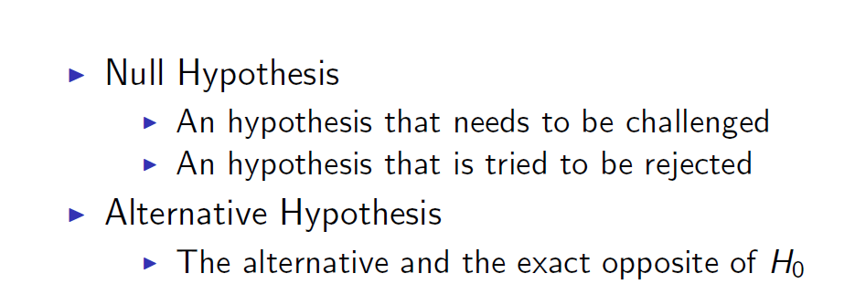
Hypothesis Testing Basics
Notes:
3
3

Slide 4
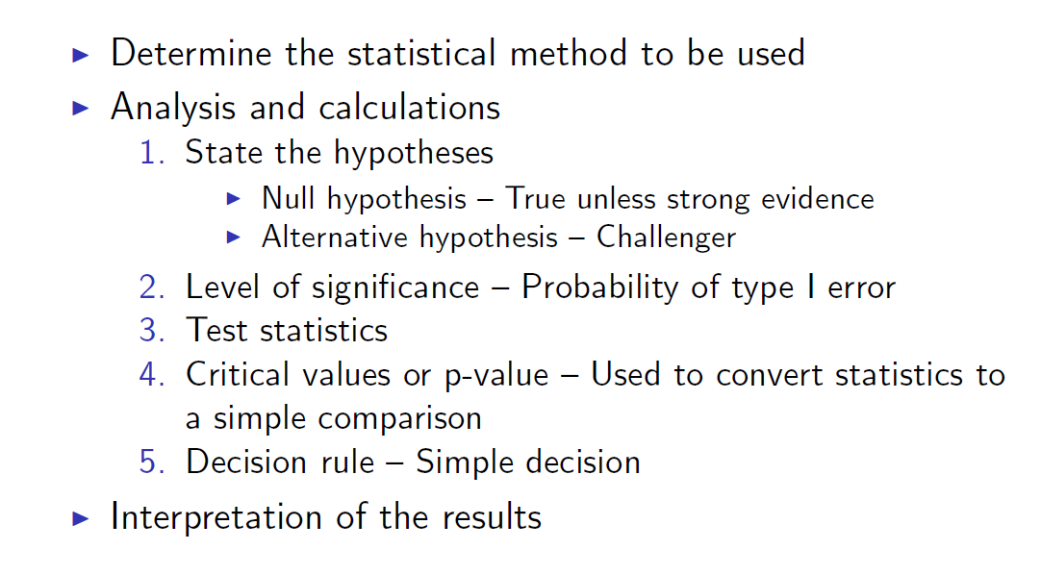
Hypothesis testing stages and steps
Notes:
4
4

Slide 5
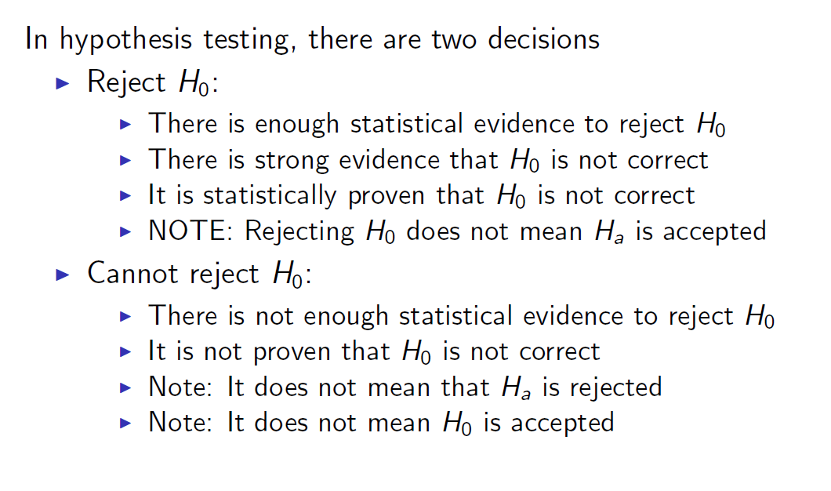
Decision step for hypothesis testing
Notes:
5
5

Slide 6
Hypothesis Tests of μ, Given x Is Normal and
σ is known

Slide 7
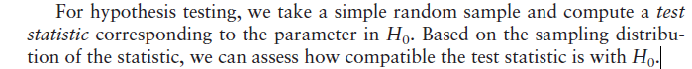
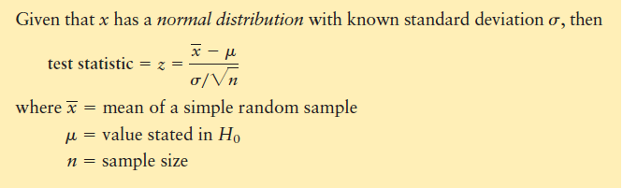
Notes:
7
7

Slide 8
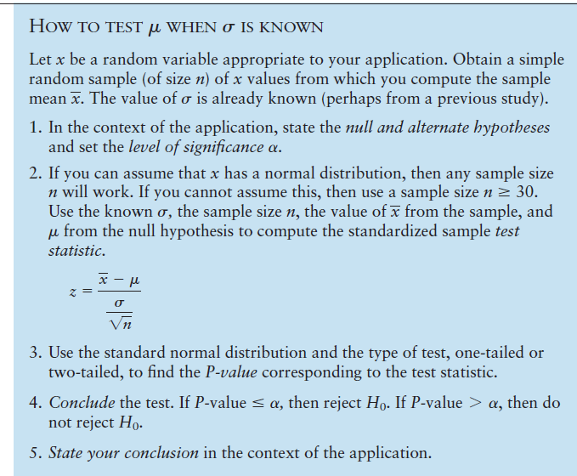
Notes:
8
8

Slide 9
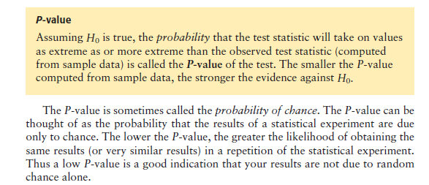
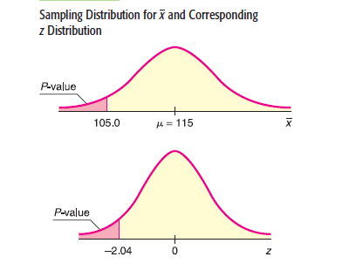
P VALUE
Notes:
9
9
P aslında farkın şanstan kaynaklanma olasılığını gösterir

Slide 10
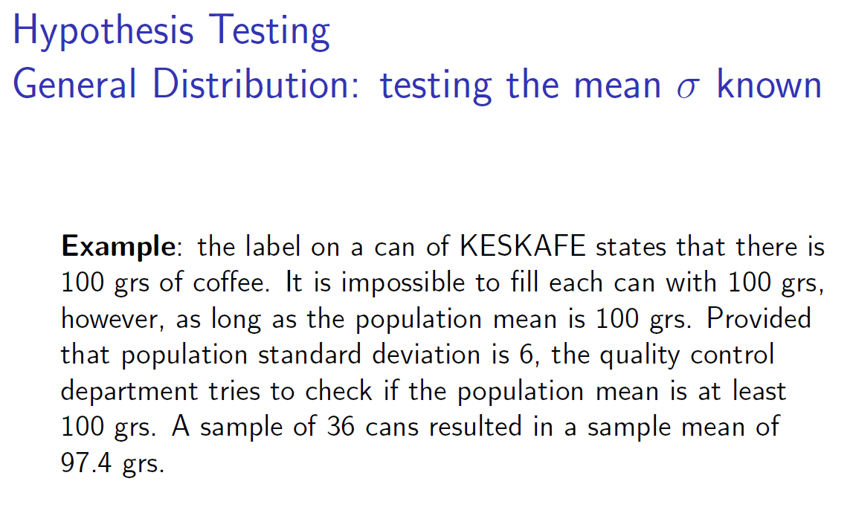
Notes:
10
10

Slide 11

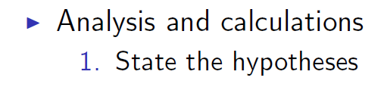
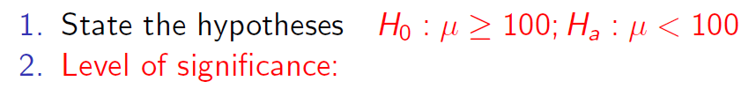
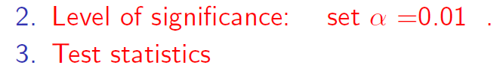
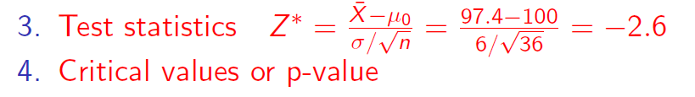
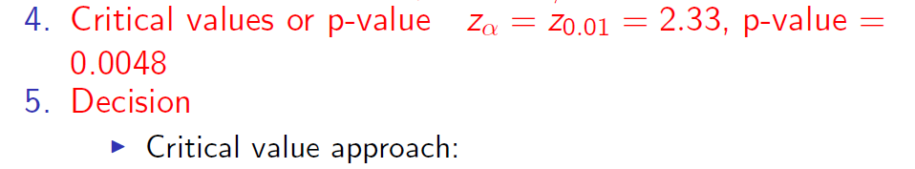
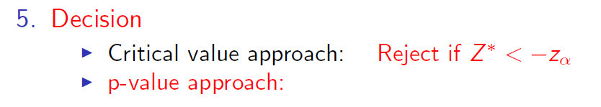
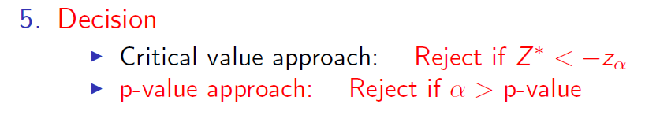
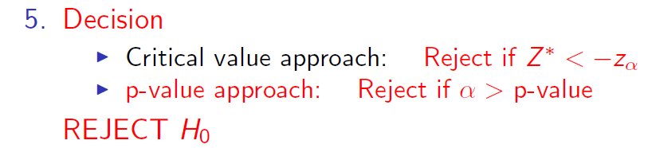

=+NORMSDIST(2.6) | =1-M19
0.9953 | 0.0047
Notes:
11
11

Slide 12
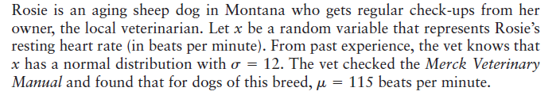
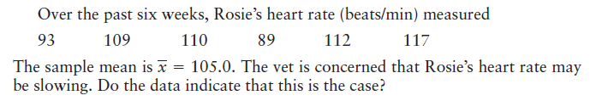
Statistical testing preview
Notes:
12
12

Slide 13
Notes:
13
13

Slide 14
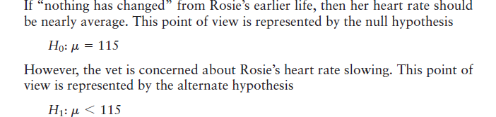
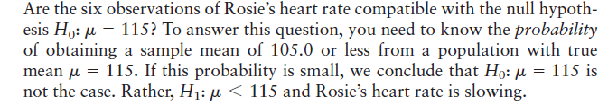
Notes:
14
14

Slide 15
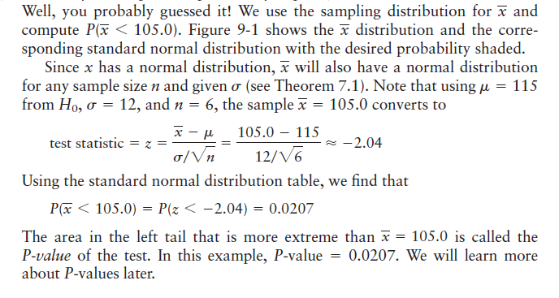
Notes:
15
15

Slide 16
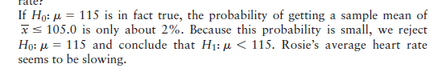

Notes:
16
16

Slide 17
Hypothesis Tests of μ, Given x Is Normal and
σ is unknown

Slide 18
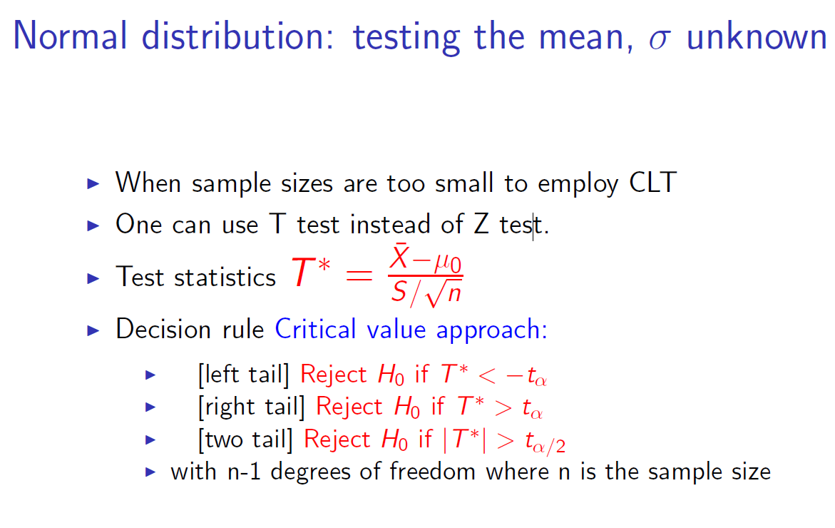
Notes:
18
18

Slide 19
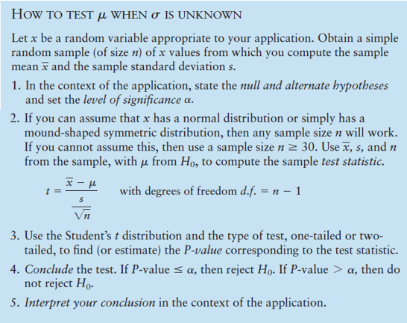
Notes:
19
19

Slide 20
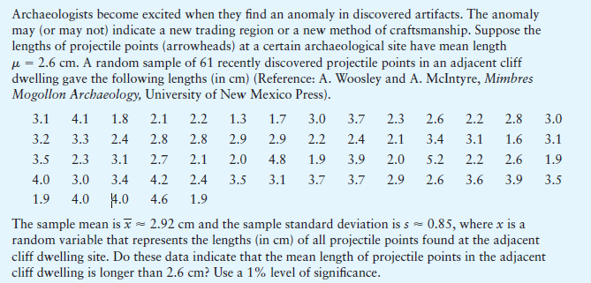
Example t1
Notes:
20
20
Arkeologlar, keşfedilen eserlerde bir anormallik bulduklarında heyecanlı olurlar. Anomali yeni bir ticaret bölgesini veya yeni bir işçilik yöntemini gösterebilir. Belli bir arkeolojik alan üzerindeki mermi noktalarının uzunluğu (ok uçlarının) ortalama uzunluğu mean=2,6 cm. Bitişik bir uçurumda yakın zamanda keşfedilen mermi puanlarının rastgele seçilmiş 61 örneği

Slide 21
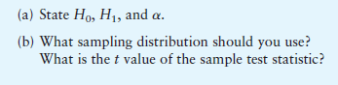

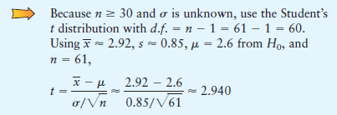
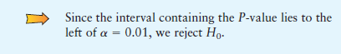
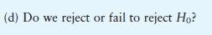
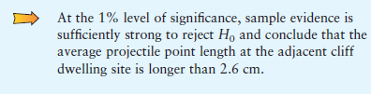
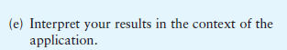
Example t1
Notes:
21
21

Slide 22
Testing a Proportion p

Slide 23
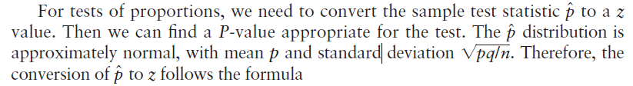
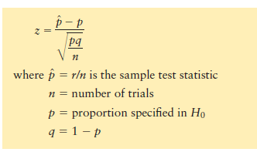
Testing a Proportion p
Notes:
23
23

Slide 24
Example p
A team of eye surgeons has developed a new technique for a risky eye operation to restore the sight of people blinded from a certain disease. Under the old method, it is known that only 30% of the patients who undergo this operation recover their eyesight. Suppose that surgeons in various hospitals have performed a total of 225 operations using the new method and that 88 have been successful (the patients fully recovered their sight). Can we justify the claim that the new method is better than the old one? (Use a 1% level of significance.)
Notes:
24
24

Slide 25
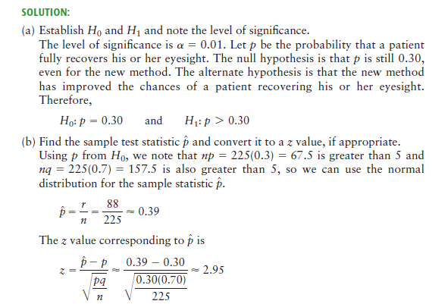
Example p
Notes:
25
25

Slide 26
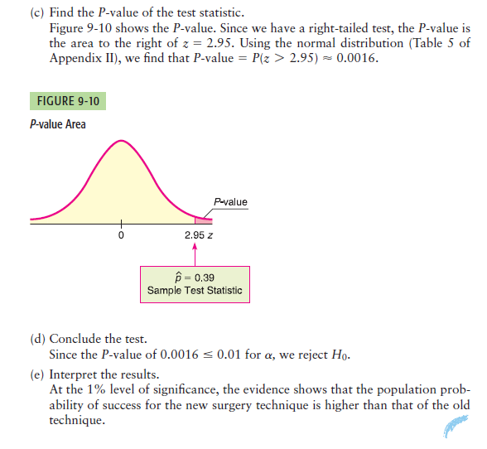
Example p
Notes:
26
26

Slide 27
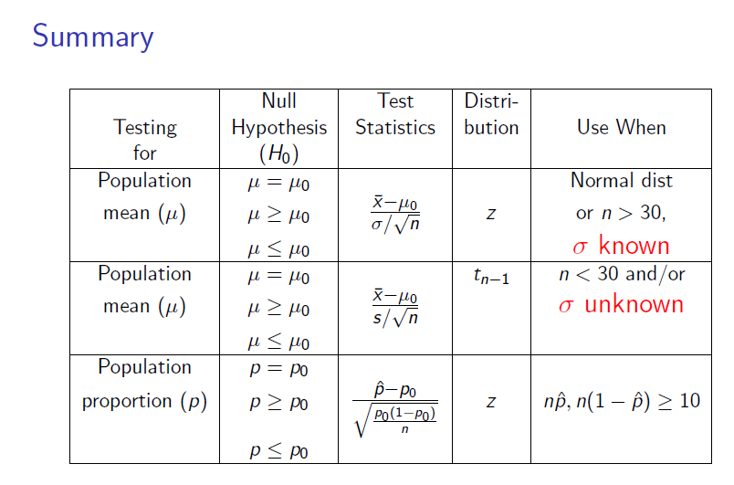
Notes:
27
27

Slide 28
Hypothesis testing involving multiple samples

Slide 29
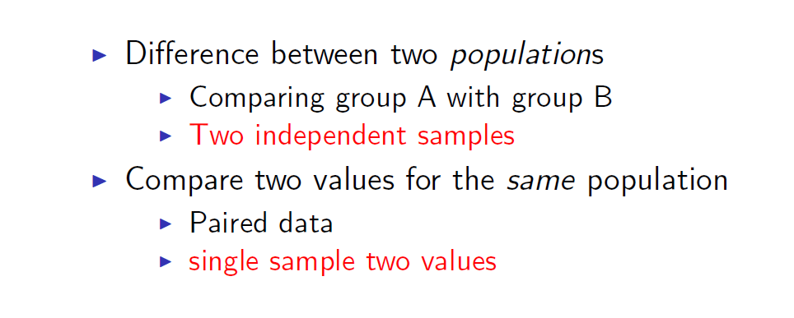
Hypothesis testing involving multiple samples
Notes:
29
29

Slide 30
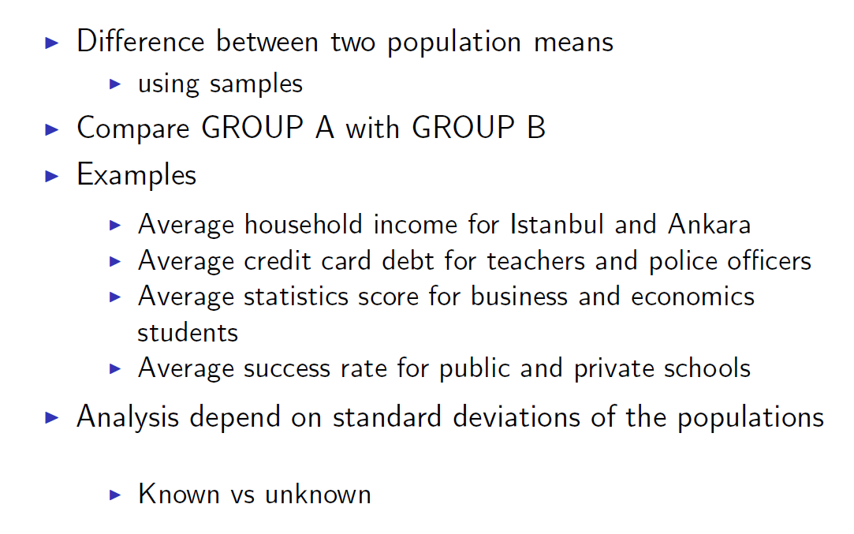
Hypothesis testing involving multiple samples
Notes:
30
30

Slide 32
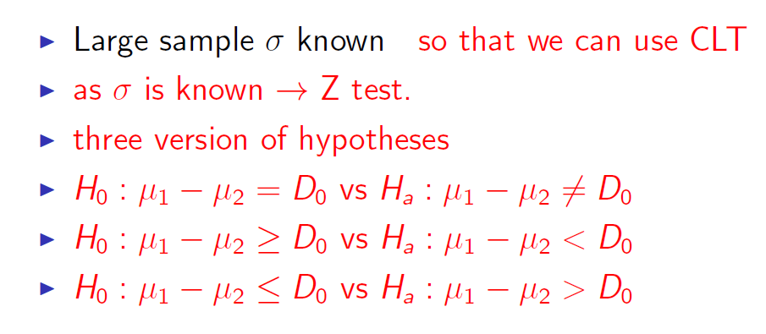
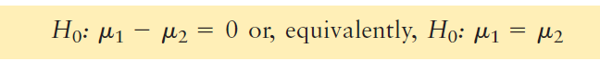
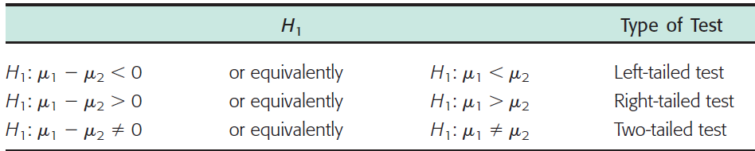
Testing the difference between two means
Notes:
32
32

Slide 33
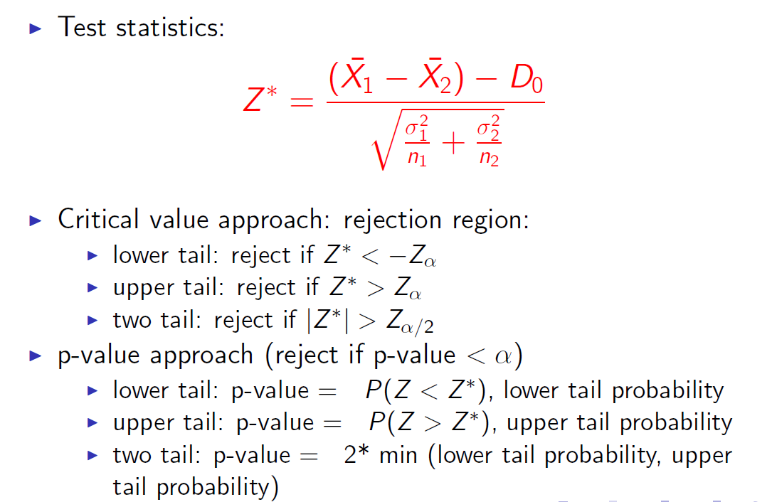
Testing the difference between two means
Notes:
33
33

Slide 34
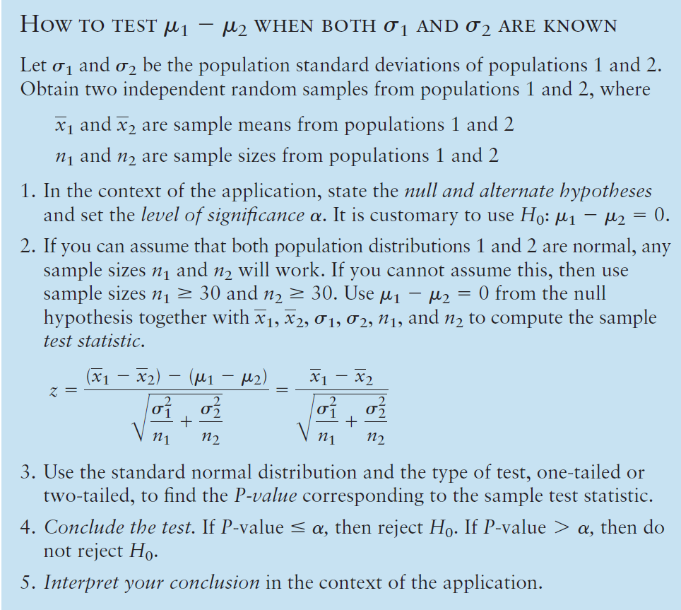
Notes:
34
34

Slide 35
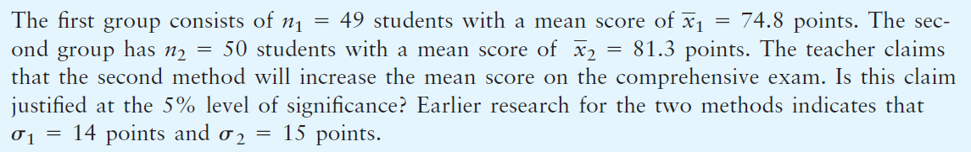
Example
A teacher wishes to compare the effectiveness of two teaching methods for her students. Students are randomly divided into two groups. The first group is taught by method 1; the second group, by method 2. At the end of the course, a comprehensive exam is given to all students.
Notes:
35
35

Slide 37
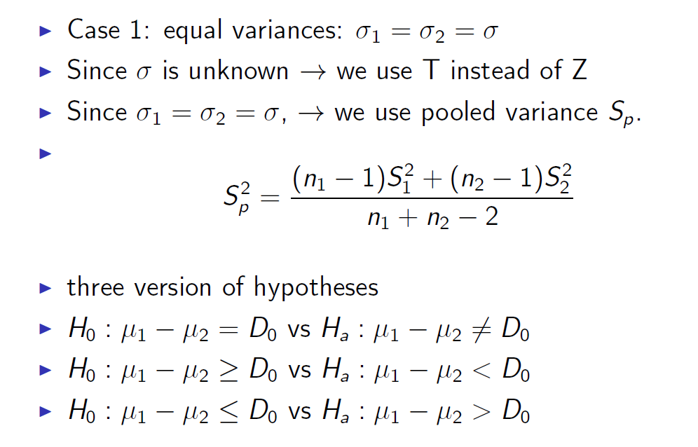
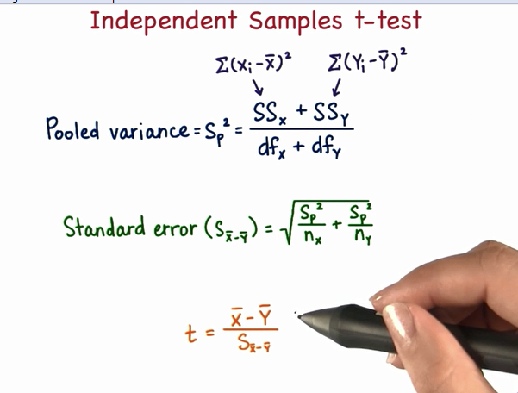
Testing the difference between two means
Notes:
37
37

Slide 38
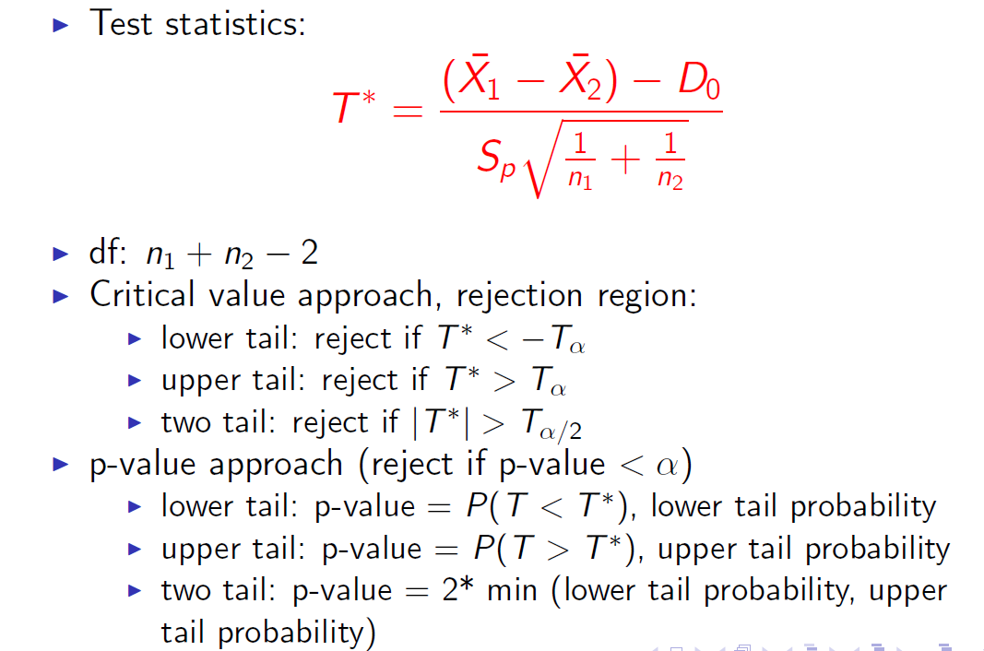
Testing the difference between two means
Notes:
38
38

Slide 39
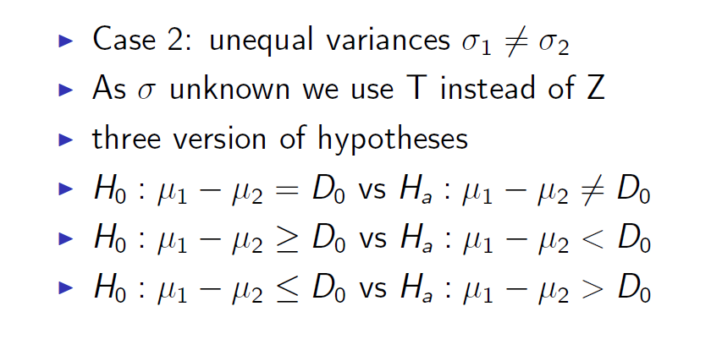
Testing the difference between two means
Notes:
39
39

Slide 40
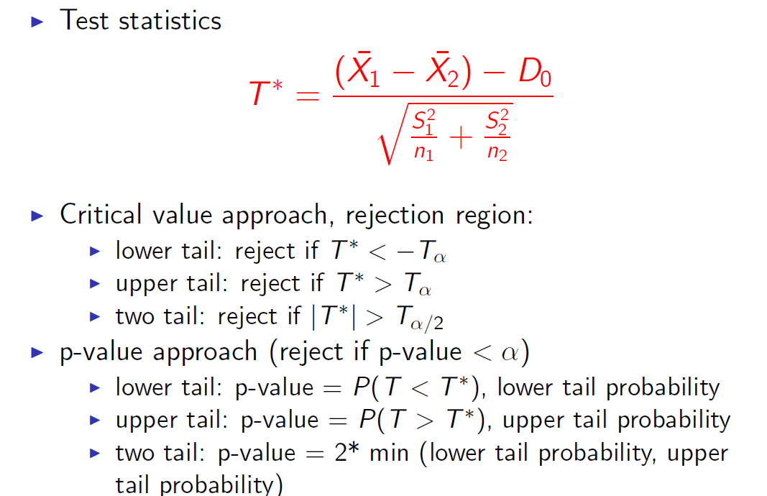
Testing the difference between two means
Notes:
40
40

Slide 41

Testing the difference between two means
Degrees of freedom for unequal variances
Notes:
41
41

Slide 42

Testing the difference between two means
Notes:
42
42

Slide 43

Testing the difference between two means
Notes:
43
43

Slide 44
Tests Paired Differences (Dependent Samples)

Slide 45
Paired data
Many statistical applications use paired data samples to draw conclusions about the difference between two population means. Data pairs occur very naturally in “before and after” situations, where the same object or item is measured both before and after a treatment.
Applied problems in social science, natural science, and business administration frequently involve a study of matching pairs.
Notes:
45
45

Slide 46


Hypotheses for testing the mean of paired differences
Consider a random sample of n data pairs. Suppose the differences
d between the first and second members of each data pair are (approximately) normally distributed, with population mean Then the t values:
Notes:
46
46

Slide 47

Hypotheses for testing the mean of paired differences
Notes:
47
47

Slide 48



Hypotheses for testing the mean of paired differences
Notes:
48
48

Slide 49
Example paired test
A team of heart surgeons at Saint Ann’s Hospital knows that many patients who undergo corrective heart surgery have a dangerous buildup of anxiety before their scheduled operations.
The staff psychiatrist at the hospital has started a new counseling program intended to reduce this anxiety. A test of anxiety is given to patients who know they must undergo heart surgery. Then each patient participates in a series of counseling sessions with the staff psychiatrist. At the end of the counseling sessions, each patient is retested to determine anxiety level. Example_paired_test.xls results for a random sample of nine patients. Higher scores mean higher levels of anxiety. From the given data, can we conclude that the counseling sessions reduce anxiety? Use a 0.01 level of significance.
Notes:
49
49
Saint Ann Hastanesi'ndeki kalp cerrahlarından oluşan bir ekip, düzeltici kalp ameliyatı geçiren birçok hastanın planlanan operasyonlarından önce tehlikeli bir kaygı oluşturduğunu bilir. Hastanedeki personel psikiyatristi, bu endişeyi azaltmak için yeni bir danışmanlık programı başlattı. Kalp ameliyatı geçirmesi gerektiğini bilen hastalara anksiyete testi verilir. Ardından her hasta, personel psikiyatrıyla birlikte bir dizi danışma oturumuna katılır. Danışma oturumlarının sonunda, her hasta anksiyete düzeyini belirlemek için tekrar test edilir. Tablo 9-8, dokuz hastanın rassal bir örneğinin sonuçlarını göstermektedir. Yüksek puanlar anksiyete düzeyinin artması anlamına gelir. Verilen verilerden, danışma oturumlarının kaygı düzeyini düşürdüğü sonucuna varabilir miyiz? 0.01 düzeyinde bir önem kullanın.

Slide 50
Testing the difference between population proportions

Slide 51

Testing the difference between population proportions
Notes:
51
51

Slide 52

Testing the difference between population proportions
Notes:
52
52

Slide 53


Testing the difference between population proportions
Notes:
53
53

Slide 54

Testing the difference between population proportions
Notes:
54
54

Slide 55

Notes:
55
55

